Slide 1
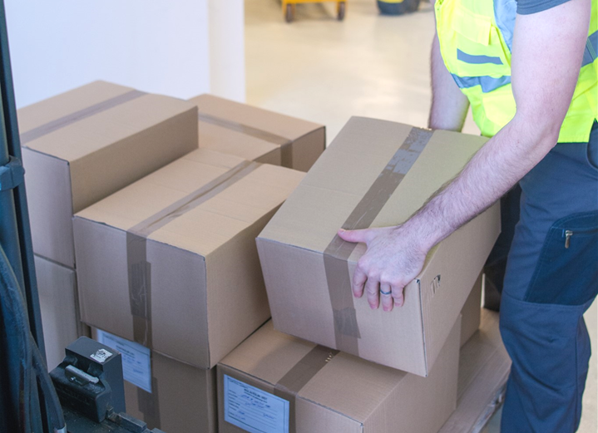
Avoiding Back Injuries

Slide 2
Welcome
Back injuries are among the most common workplace injuries
Causes of back injuries and ways to avoid them

Slide 3
Session Objectives
Describe types of back injuries and their symptoms
Recognize hazards
Identify and mitigate risk factors
Implement equipment and techniques to prevent back injuries

Slide 4
Every Move You Make
Stand
Sit
Bend
Reach
Turn
Push/pull
Lift/carry

Slide 5
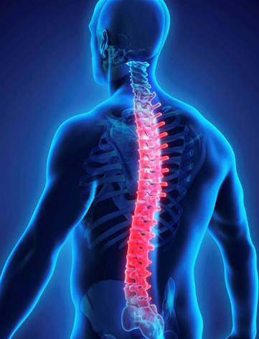
Proper Posture
Maintain back’s curve
Standing
Sitting
Walking

Slide 6
Anatomy of the Back
Vertebrae
Nerves
Disks
Muscles,
Ligaments, and Tendons

Slide 7
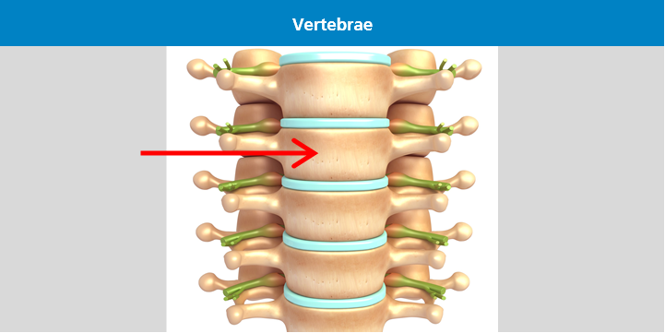
Anatomy of the Back
Vertebrae
Nerves
Disks
Muscles,
Ligaments, and Tendons

Slide 8
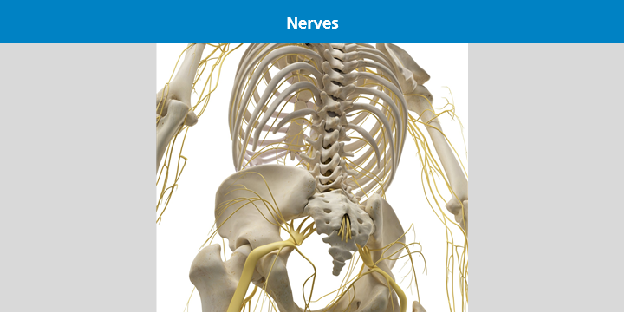
Anatomy of the Back
Vertebrae
Nerves
Disks
Muscles,
Ligaments, and Tendons

Slide 9
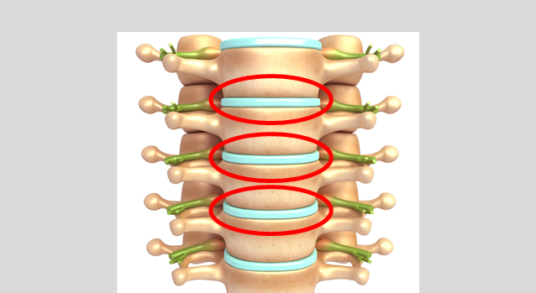
Anatomy of the Back
Vertebrae
Nerves
Disks
Muscles,
Ligaments, and Tendons

Slide 10
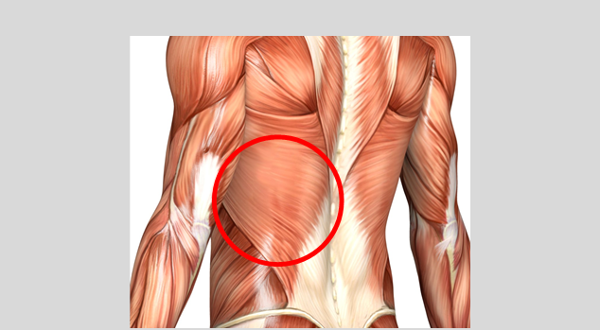
Anatomy of the Back
Vertebrae
Nerves
Disks
Muscles,
Ligaments, and Tendons

Slide 11
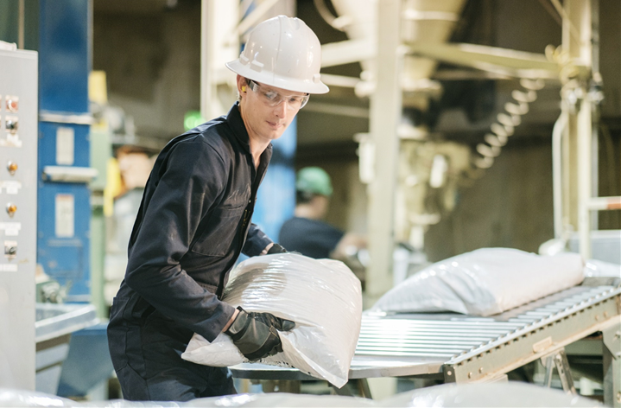
Types of Back Injuries
Strain
Sprain
Herniated Disk

Slide 12
Signs and Symptoms: Sprains and Strains
Muscle pain and tenderness
Muscle spasms
Decrease in muscle strength

Slide 13
Signs and Symptoms: Herniated disk
Pain
Weakness
Numbness

Slide 14
Risk Factors for Back Injuries
Fitness Level
Excess Weight
Age
Medical Conditions

Slide 15
Risk Factors for Back Injuries
Fitness Level
Excess Weight
Age
Medical Conditions

Slide 16
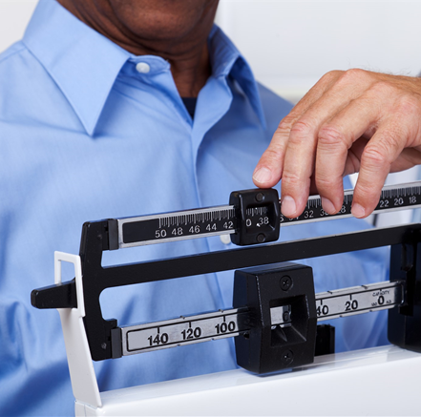
Risk Factors for Back Injuries
Fitness Level
Excess Weight
Age
Medical Conditions

Slide 17
Risk Factors for Back Injuries
Fitness Level
Excess Weight
Age
Medical Conditions

Slide 18
Risk Factors for Back Injuries
Fitness Level
Excess Weight
Age
Medical Conditions

Slide 19
Mitigating Risk Factors
Strengthening
Flexibility
Losing weight

Slide 20
Occupational Hazards
Lifting and carrying heavy loads
Long duration or repeated lifting and carrying
Lifting and unloading loads outside of the “power zone”
Awkward postures

Slide 21
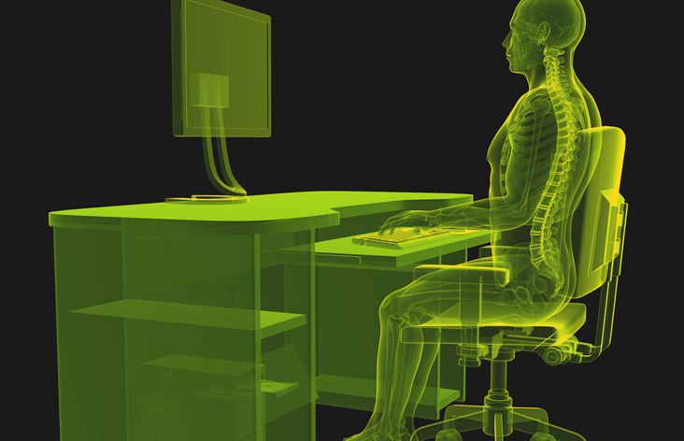
Controlling Hazards: Engineering Controls
Lifting equipment
Ergonomics

Slide 22
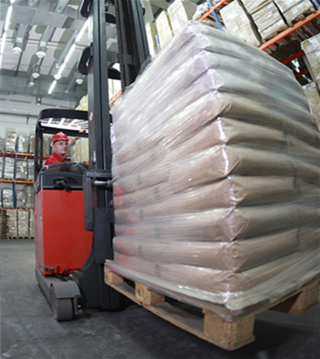
Lifting Equipment
Powered equipment

Slide 23
Lifting Equipment
Manual equipment

Slide 24
Ergonomics
Keep items within reach
Use a headset
Monitor at eye level
Supportive chair

Slide 25
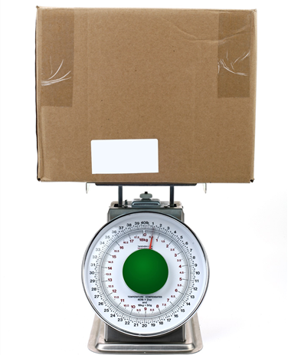
Controlling Hazards: Safe Work Practices
Never lift an object that is too heavy for you to manage safely.

Slide 26
Have a Lifting Plan
Size up the load
Clear a path
Think about unloading

Slide 27
Proper Technique: Lifting
Introduction
Never lift an object that is too heavy for you to manage safely.
Step 1
Step 2
Step 3
Step 4

Slide 28
Proper Technique: Lifting
Step 1
Stand close
Feet shoulder-width apart
Center the load
Step 1
Step 2
Step 3
Step 4

Slide 29
Proper Technique: Lifting
Step 2
Bend at knees
Maintain body’s natural curve
Step 1
Step 2
Step 3
Step 4

Slide 30
Proper Technique: Lifting
Step 3
Pull load close
Grip firmly
Step 1
Step 2
Step 3
Step 4

Slide 31
Proper Technique: Lifting
Step 4
Tighten stomach
Power lift with legs
Step 1
Step 2
Step 3
Step 4

Slide 32
Proper Technique: Carrying
Make sure you can see
Take small, stable steps
Don’t twist

Slide 33
Proper Technique: Unloading
Squat
Keep back straight
Watch fingers

Slide 34
Special Situations: Introduction
Team lift
Overhead lift

Slide 35
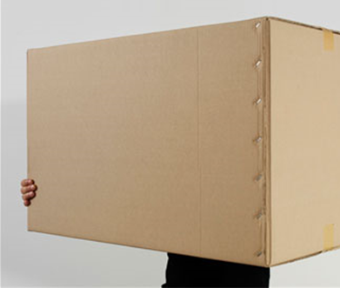
Special Situations: Team Lifts
Select
Coordinate
Lift
Carry
Unload
Some loads are too big or heavy for one person. These require team lifting.

Slide 36
Special Situations: Team Lifts
Select
Coordinate
Lift
Carry
Select members of the lifting team with height in mind. Working with others of about the same height will help keep the load stable and level while you’re carrying it.
Unload

Slide 37
Special Situations: Team Lifts
Select
Coordinate
Lift
Carry
Designate a team leader for the lift to direct all the motions. No one should do anything unless the leader says so. This will prevent someone from being injured if another member of the team does something unexpected.
Unload

Slide 38
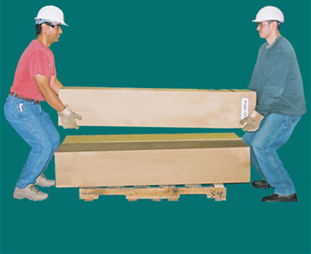
Special Situations: Team Lifts
Select
Coordinate
Lift
Carry
Members of the team should lift the load
slowly and at the same time. Avoid walking backward, but if it is not possible, consider having another person who is not part of
the lifting team act as a spotter.
Unload

Slide 39
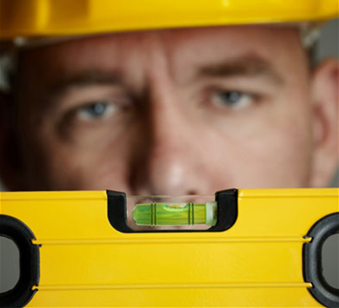
Special Situations: Team Lifts
Select
Coordinate
Lift
Carry
Keep the load level while you carry it. This is particularly important if you are going up or down stairs or ramps. The person at the bottom will take more of the load if it is allowed to tilt downward instead of remaining level.
Unload

Slide 40
Special Situations: Team Lifts
Select
Coordinate
Lift
Carry
When it’s time to unload, team members should unload slowly and together, following the directions of the team leader.
Unload

Slide 41
Special Situations: Overhead Loads
Shoulders level with load
Slide load close
Maintain good posture
Use a spotter

Slide 42
Don’t Ignore an Injury
Report the injury
Seek medical care

Slide 43
Key Points to Remember
Common injuries: sprains, strains, herniated disks
Hazards: carrying heavy loads, repetitive lifts, awkward postures
Lose weight, exercise, and stretch to mitigate risk factors
Use proper techniques to reduce risk of injury

